Slide 1

Two Types of Legal Systems: Criminal Law & Civil Law

Slide 2
Criminal vs. Civil Trials
Theater in Criminal Trials
http://www.youtube.com/watch?v=f98j9X4_OrI
OJ Civil Trial outcome -1997
http://abcnews.go.com/Archives/video/feb-1997-oj-simpson-civil-trial-verdict-9602762

Slide 3
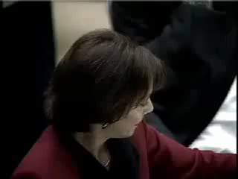
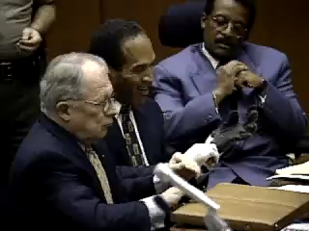
3 OJ Simpson Trials: Criminal and Civil and the Court of Public Opinion
The case became about race (Mark Fuhrman)
“If the gloves don’t fit, you must acquit!”

Slide 4
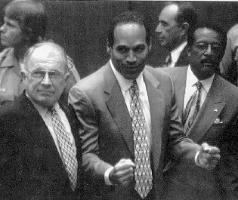
Criminal Laws
An infraction against the State (The People/gov’t)
CLs are made to do the following:
1. regulate public conduct
2. set out responsibilities owed to society (If you do this, here is the consequence)
People of the State of California v. OJ Simpson

Slide 5
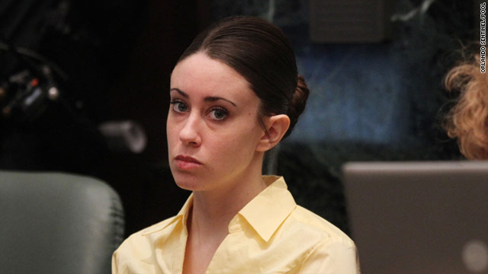
Criminal Laws (cont’d)
When a criminal case takes place, legal action is brought by the State against the accused individual
People of the State of Florida v. Casey Anthony

Slide 6
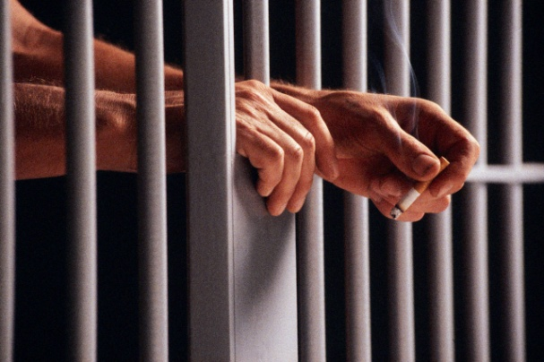


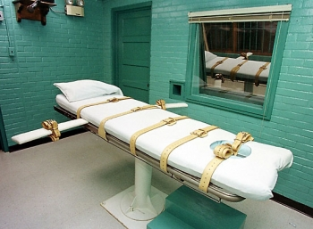
Criminal Laws (cont’d)
What happens when you break a criminal law?
1. incarceration
2. monetary fines
3. some kind of supervision (house arrest, probation, etc.)
4. death penalty (possibility only in capital murder trials)

Slide 7
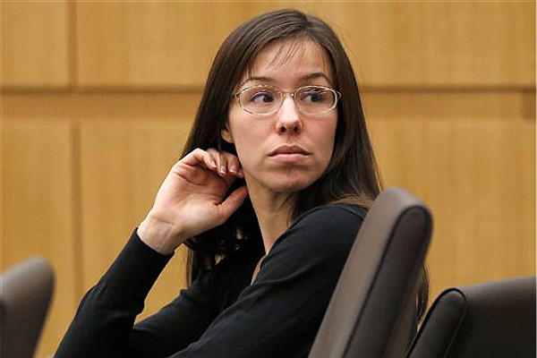

Criminal Laws (cont’d)
In the US, we have two types of criminal offenses
1. felony – a serious crime that carries a penalty at least 3 or more years in prison
2. misdemeanor – lesser crime with a lesser penalty (fine, probation) than a felony
The People of the State of Arizona v. Jody Arias

Slide 8
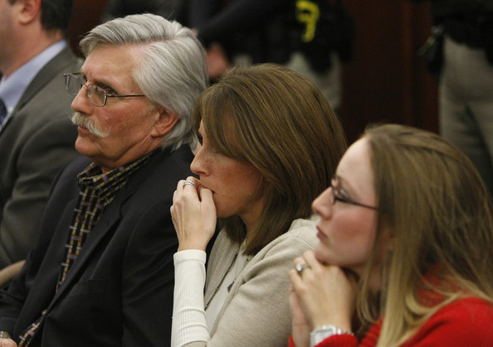
Civil Laws
These laws regulate relations between individuals and groups
These cases often result in what we call a civil action (lawsuit)
Ron Goldman and his wife filed suit against Simpson and he was found to be liable in this very famous wrongful death suit
Philadelphia – trailer 1993
http://www.youtube.com/watch?v=l433n5zAxAU

Slide 9
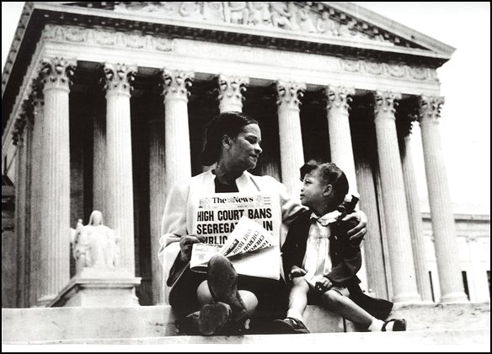
Civil Laws (cont’d)
A lawsuit is brought by one party against another (“suing” someone)
Complaint usually involves some kind of wrongdoing or bodily injury
The penalty in a civil action is usually monetary compensation
Linda Brown’s father filed suit against the Board of Education in Topeka, Kansas. This was a class action suit. They weren’t seeking $. They wanted equal access to school. Constitutional Law!

Slide 10
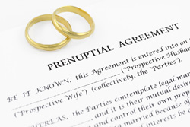
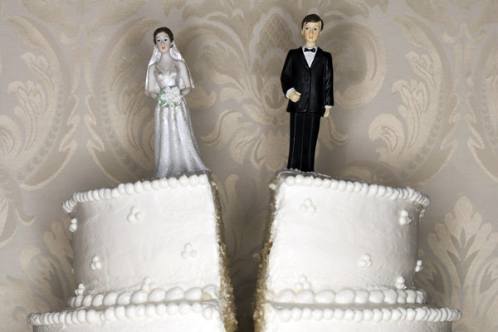
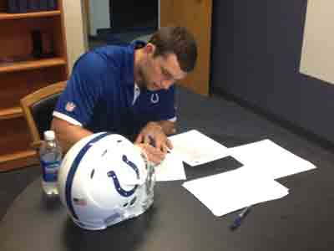
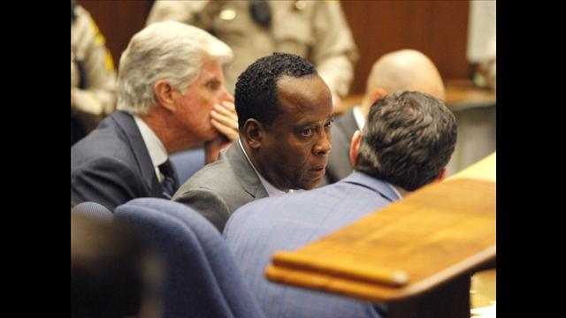
Civil Laws (cont’d)
Civil laws also regulate the following:
1. marriage or divorce
2. contracts between two or more parties
3. protecting against negligence (irresponsible behavior)
Dr. Murray in the wrongful death case of Michael Jackson
Andrew Luck signing his NFL contract

Slide 11
Differences Between Criminal and Civil Court Cases
Criminal Case:
1. think government vs. defendant
2. defendant is innocent until proven guilty by the gov’t
3. that guilt must be proven beyond a reasonable doubt through a unanimous decision by a jury

Slide 12
Differences (cont’d)
Civil Case
Think plaintiff vs. defendant
Plaintiff is the one who claims to be wronged (the one suing the defendant)
In this case, a plaintiff can win by preponderance, meaning the defendant is “probably” or “most likely” (50% positive) responsible for injury (does not require a unanimous jury decision)

Slide 13
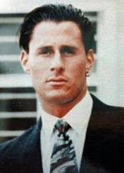
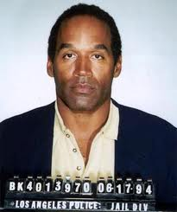
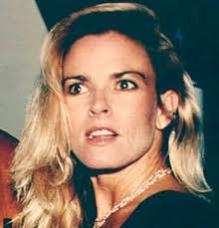
Crime of the Century
OJ Simpson – NFL HOF, film star
Married twice….5 kids
Divorced in 1992 after tumultuous relationship with Nicole Brown Simpson (numerous reports of battery)
Murder of Nicole Brown Simpson and Ron Goldman takes place in June of 1994 (her throat slit to the point of near decapitation and he was stabbed 30+ times)
October of 1995, the trial ends with a verdict of not guilty
1997 civil trial ends with OJ having to pay $33 million (of which he has paid very little….ends up being $8.5 million, they can ‘t go after his pension
Assets seized: Brentwood home, Heisman Trophy, golf clubs, sports memorabilia
Currently serving 9 years without parole for robbery and other felonies committed in Las Vegas in 2007 (so much more:
http://law2.umkc.edu/faculty/projects/ftrials/Simpson/simpson.htm

